Slide 1

Z-HEALTH
Behavioural Interventions as Primary Prevention for Non-Communicable Diseases Among Young People
March 10, 2026

Slide 2
AGENDA
OVERVIEW
Presentation of the framework: habit pathway and life-course transition (ICL – 20 min.)
Questions and Answers (ALL PARTNERS – 20 min.)
INTERVENTIONS
Presentation of common feature (new PERT diagram) (ICL - 20 min.)
Discussion on vertical and horizontal WPs: leadership, participation and partner gaps (ALL PARTNERS - 30 min.)
Presentation on intervention components (ALL PARTNERS - 10 min. each)
FINANCIAL & ADMINISTRATIVE ISSUES
Update (ISINNOVA/ICL – 5 min.)
NEXT ACTIONS
Reminder of timetable (ICL(ISINNOVA – 5 min.)
Core Parameters
Action Type: Research & Innovation Action (RIA)
Total Budget: €10 million
Projects Funded: 2
Opens: February 10, 2026
Closes: April 16, 2026

Slide 3
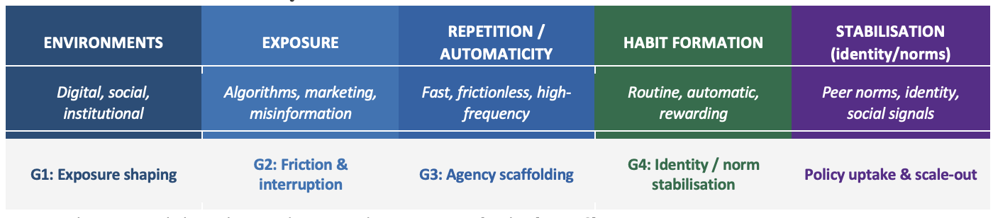
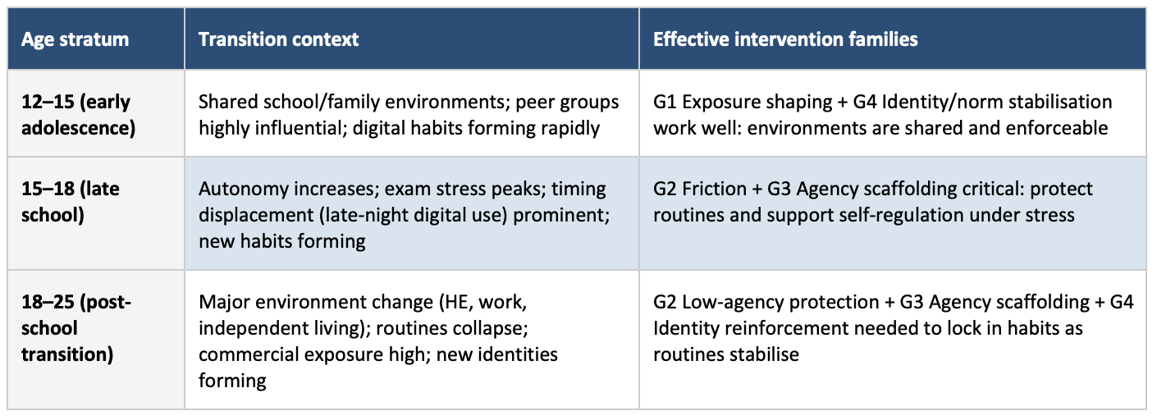
Presentation of the framework: habit pathway and life-course transition
Core Parameters
Action Type: Research & Innovation Action (RIA)
Total Budget: €10 million
Projects Funded: 2
Opens: February 10, 2026
Closes: April 16, 2026

Slide 4
Questions and Answers
(ALL PARTNERS – 20 min.)

Slide 5
Presentation of common feature
WP3 – NCD Evidence Framework & Disease Context
Obesity and cardio-metabolic health Mental health Addictions
WP4 – Multi-component Intervention 1, Co-creation and Planning:
Lower secondary school/ early adolescence (age 12–15)
WP5 – Multi-component Intervention 2, Co-creation and Planning:
Upper secondary school/ late adolescence (age 16–18)
WP1 Project Coordination & Management
WP6 Intervention Implementation in Countries
WP8
Modelling,
Policy Simulation
& Foresight
WP2 Ethics
WP7 Evaluation
WP9 Communication, Stakeholder engagement, Dissemination & Exploitation

Slide 6
Discussion on vertical and horizontal WPs: leadership, participation and partner gaps (ALL PARTNERS - 30 min.)

Slide 7
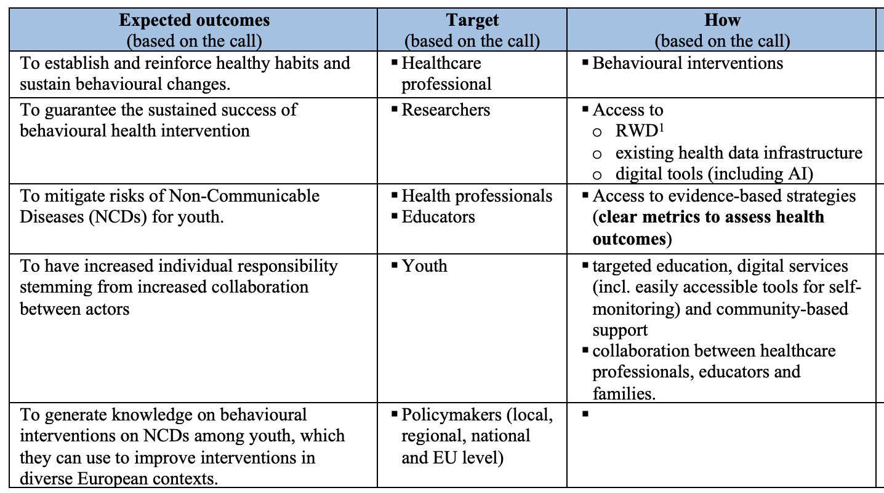
ACTORS and OUTCOMES

Slide 8
Presentation on intervention components
(ALL PARTNERS - 10 min. each)

Slide 9
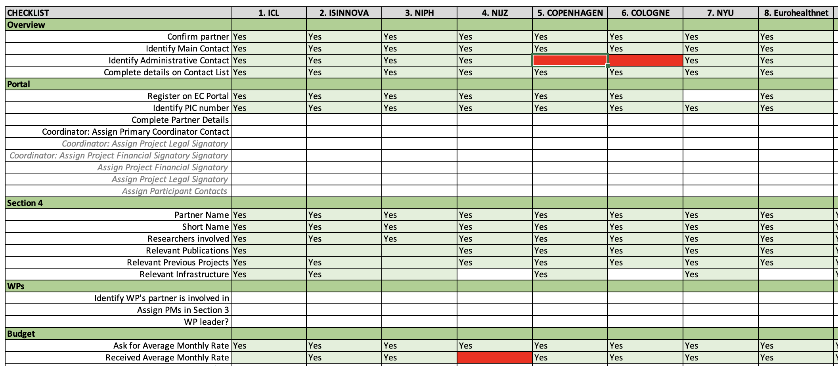
FINANCIAL & ADMINISTRATIVE ISSUES
Core Parameters
Action Type: Research & Innovation Action (RIA)
Total Budget: €10 million
Projects Funded: 2
Opens: February 10, 2026
Closes: April 16, 2026

Slide 10
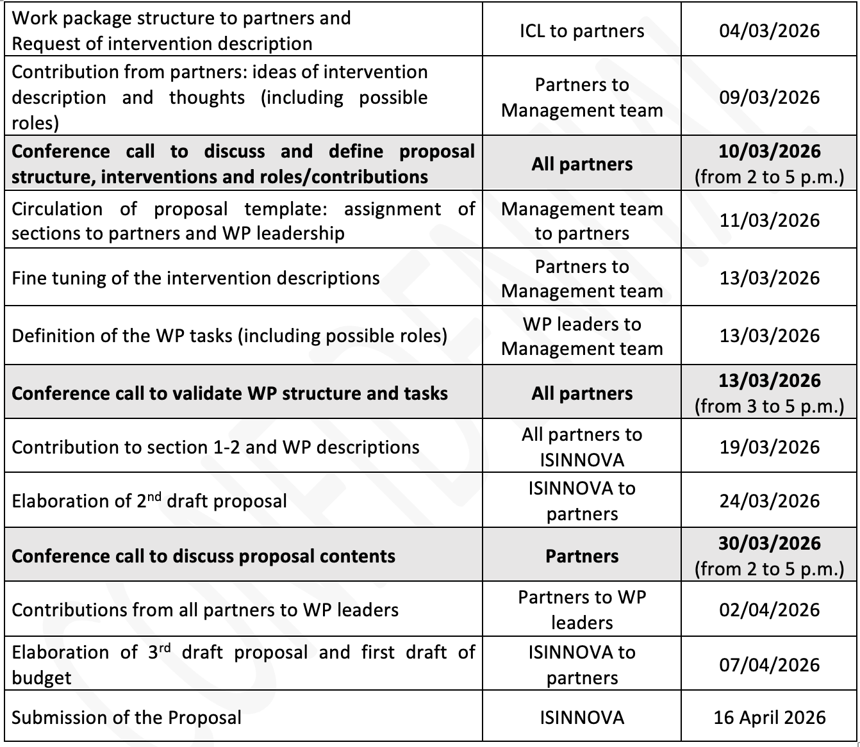
NEXT ACTIONS
Core Parameters
Action Type: Research & Innovation Action (RIA)
Total Budget: €10 million
Projects Funded: 2
Opens: February 10, 2026
Closes: April 16, 2026

