Slide 1
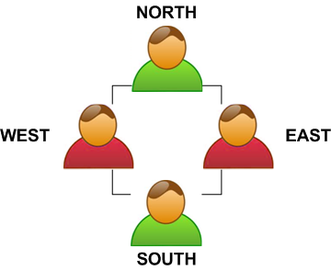
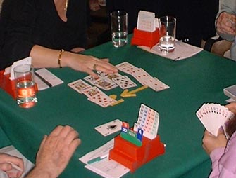
The Game of Bridge
trick-taking game using 52-card deck
4 players in two competing partnerships with partners sitting opposite each other
The game consists of:
- dealing the cards
- bidding
- playing the hand
- scoring
Basic rules:
- each player is dealt 13 cards
- the dealer starts the auction which continues clockwise
- once bidding is finished and the final contract is established, a player left to the declarer leads a card, this may be any card from his hand
- the next player (declarer’s partner) then puts his cards down
so that everyone can see them and he is known as ‘dummy’
- the declarer asks for one card from dummy’s hand following
the suit led (doesn’t have to be higher)
- the other two players follow the suit as well and thus complete
a trick, then the player with the highest card wins the trick and
leads another card; this procedure is followed until all cards have been played

Slide 2
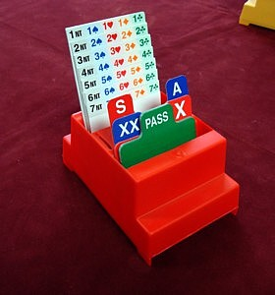
Bidding
- the dealer starts the auction by ‘passing’ or ‘bidding’ any bid
- the next player can either pass, bid higher (suits are ranked in order: no trumps, spades, hearts, diamonds, clubs) or double/redouble if the previous player bid
- this continues until three ‘pass’ cards have been played in a row (and everyone has been offered to bid) at which point the bidding stops, the last bid becomes the ‘contract’ and the player who first bid this suit becomes the declarer, his partner
will be the dummy
- for example (dealer is West):
Pass - 1♦ - Pass - 1♥ - 1♠ - 2♥ - Pass - Pass - Pass
Contract is 2♥
Hearts are trumps for this deal
The declarer will succeed if he wins at least 8 tricks out of 13
(6 + contract level)
South becomes the declarer, while North will be the dummy
West and East are the defending pair with West leading the first card
- there are many different bidding systems and each partnership usually follows one of the main ones and adds slight adjustments after some time of playing

Slide 3
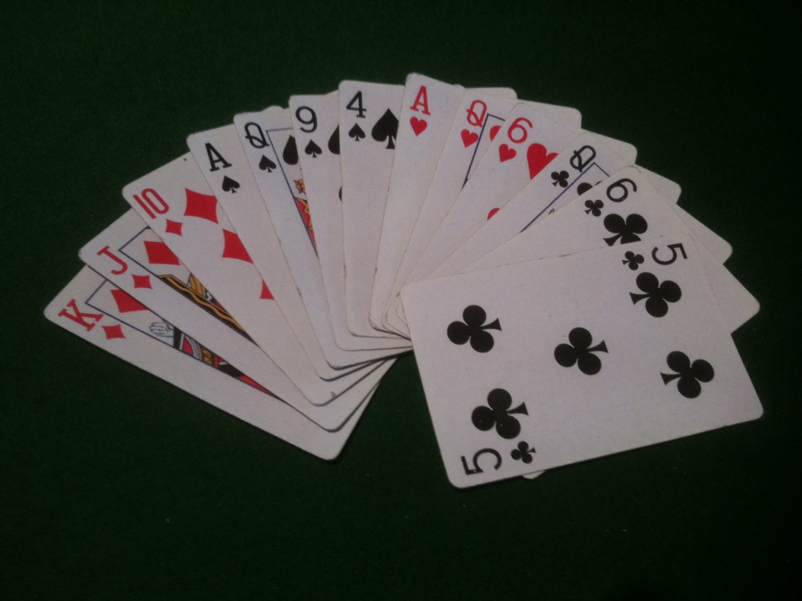
5-card Majors
- each bidding system relies on evaluating the hand first
- the easiest way is to count points in your hand:
- Ace = 4 points, King = 3 points, Queen = 2 points, Jack = 1 point
- overall there are 10 points in each suit = 40 altogether
- this bidding system focuses on finding the ‘trump fit’ (both players together having 8+ cards from one suit) in major suits (♥ or ♠) as points for contracts involving major suits give more points than those for minor suits (♣ or ♦)
How many points?
2 Aces + 1 King + 3 Queens + 1 Jack = 18
18 >> 10 = strong hand (but one has to
consider his partner’s hand as well)
Bidding system is a silent language between the two partners, each bid at each point in the auction means something specific

Slide 4
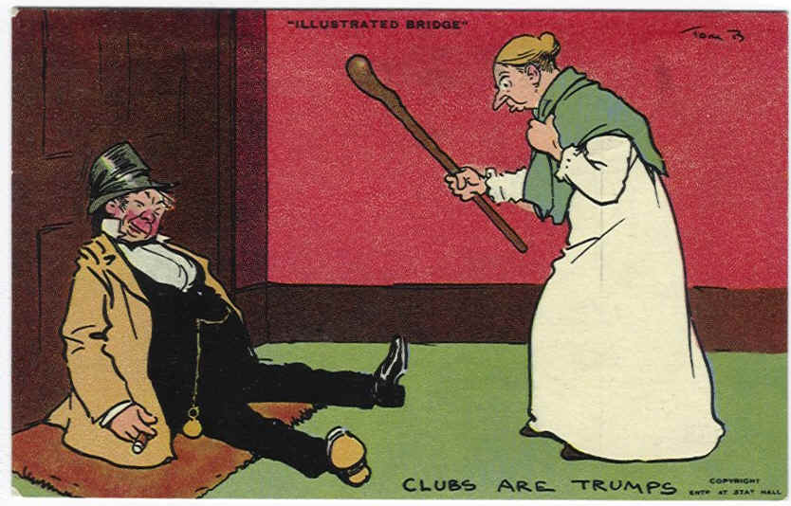
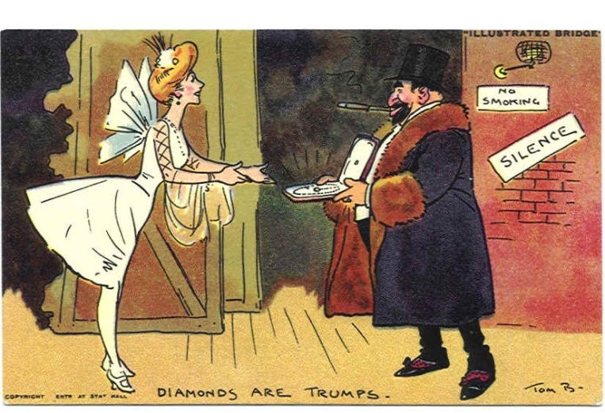
Opening Bids on 1st Level
1NT - 15-17 points, balanced hand, preferential bid (always check whether you can bid this)
- no singleton or void
- no more than 1 doubleton
- no 5-card major
- 4432, 4333, 5(minors)332
1 ♥ - 12-21 points, 5+ hearts
1 ♠ - 12-21 points, 5+ spades
1♦ - 12-21 points, no 5+ hearts or spades, 4+ diamonds
1 ♣ - 12-21 points, no 5+ hearts or spades, no 4+ diamonds
- if you have 2 5-card suits, bid the higher one first and then rebid the lower one

Slide 5
Basic Responding to 1 Suit
Pass – less than 6 points
1 of a new suit – 6+ points, 4+ length
1NT – 6-9 points, unable to bid a higher suit on 1 level
2 of a suit – 6-9 points, 3-card support (if major)
2 of a lower new suit – 10+ points, 4+ length
2NT – 10-12 points, balanced, no 4-card major
3 of a suit – 10-12 points, 3-card support (if major)
1♦ - Pass - ?
General approximate point ranges for bidding:
1 level – 20 points
2 level – 21-22 points
3 level – 23-24 points; Game bonus for NT
4 level – 25-27 points; Game bonus for NT, ♥ and ♠
5 level – 28-30 points; Game bonus for all
6 level – 31-36 points; Small slam bonus for all
7 level – 37-40 points; Grand slam bonus for all
Your hand:
♠ K 9 6 2
♥ Q 7
♦ J 10
♣ A J 8 4 3
2♣
Your bid?

Slide 6
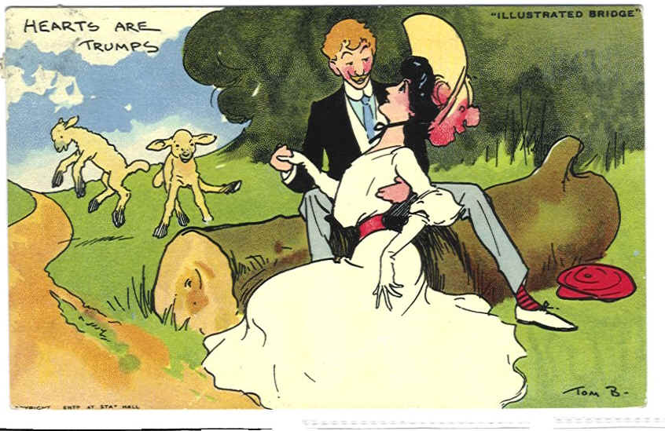
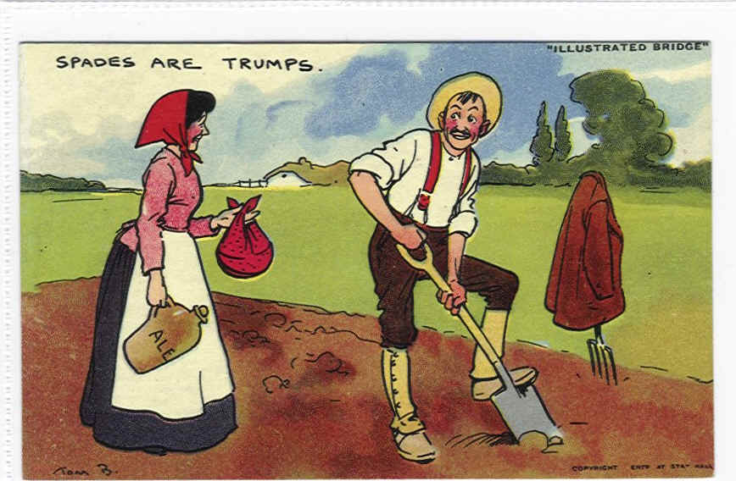
The Play
- you have to follow a suit which was led if you can, but not necessarily with a higher card
- if you don’t have the led suit, you may play any card you wish no matter what other people before you played
- if there are trump cards present in a trick, the highest trump card takes the trick
Golden rule: Second player plays low, third player plays high

