Slide 1
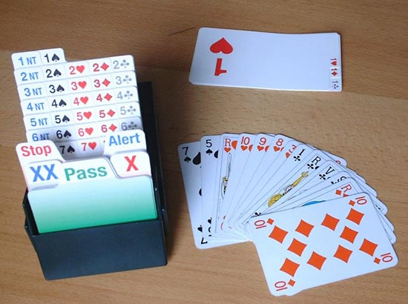
Introduction
Contract Bridge

Slide 2
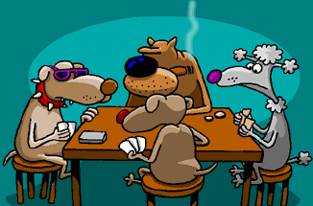
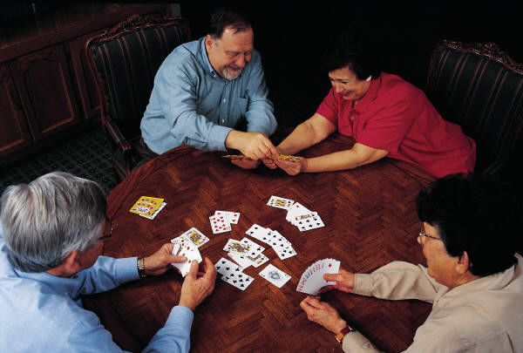
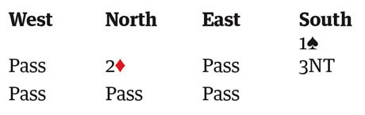
Introduction
How is it played?
Bridge is a trick-taking card game that is played by four players, each of which are dealt 13 cards.
The game is played with two competing partnerships sitting opposite each other around a table.
When the cards are dealt, the game consists of two phases: bidding and play.
Notes:
Play is quite simple: explain concept of tricks if needed. Bidding essentially betting of a side as to how many tricks they think they can make.

Slide 3
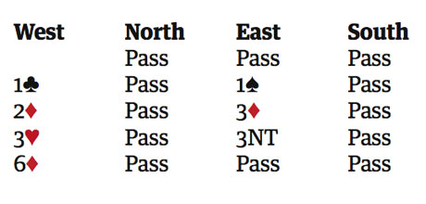
Introduction
The Bidding
The auction starts with the dealer and rotates around the table clockwise with each player making a call. Players can make more than one call in a round of bidding until 3 players in a row all Pass. At this point the partnership who makes the highest bid is said to have won the bidding and the play starts.
There are 5 ‘strains’ that can be bid:
♣ = Clubs
♦ = Diamonds
♥ = Hearts
♠ = Spades
NT = No Trumps
A bid corresponds to the number of that bid + 6 tricks.
Notes:
If you make a bid, it has to be higher than the previous bid, in level or suit rank. Pass doesn’t commit your side to more tricks, like check in poker. The goal of the bidding is for both partnerships to communicate what they have to their partner so that their partnership can reach the optimum final contract. The bridge scoring rewards accuracy of tricks bid and made.

Slide 4
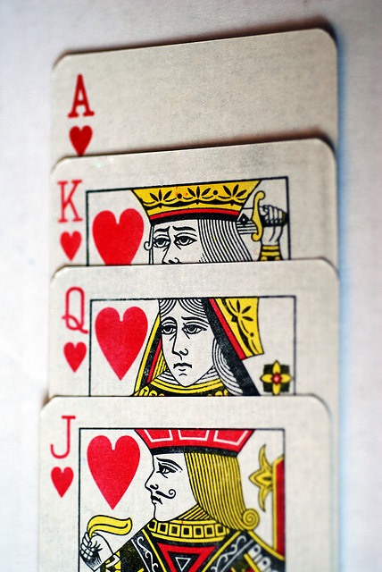
Introduction
How many tricks can my hand take?
Counting points:
Ace = 4 points
King = 3 points
Queen = 2 points
Jack = 1 point
Notes:
Goal of bidding is to see how many tricks you can make, so judge your hand based on trick-taking potential. Aces are the higher cards so they are assigned the highest value, then Kings, Queens and Jacks... The classic point count assigns 4 to Ace... 1 to Jack, adding up to a total of 40 point, 10 in each suit distributed among the players

Slide 5
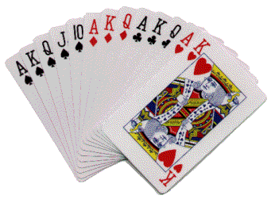
Introduction
♠ A+K+Q+J = 4+3+2+1 = 10
♥ A+K = 4+3 = 7
♦ A+K+Q = 4+3+2 = 9
♣ A+K+Q = 4+3+2 = 9
-
Total: 35 Points
Question: how many points do I need to bid normally without getting into a contract I can’t make because I won’t have enough tricks?
Answer: 12 points. When you have 12 out of the total 40 point partner will have an expected value of 9.3 hcps, a combined 21 points. Just over half the points (21/40) usually means you can make just over half the tricks (7/13).
Notes:
This hand has only top cards so it will make 13 tricks without any help from partner. It adds up to 35 points out of the total 40, showing that this is a really powerful hand in terms of taking tricks according to the point count system. It is easy to bid when you are 100% sure that you are making all the tricks, less so when you don’t have certain tricks.
For instance, what kind of hand do u need to expect to make 1 Heart or 3 Diamonds? Generally the points are still a good indicator. At the one level you need 7/13 tricks so you will need to have an average of about 21/22 points to make it (just over half of the points to make just over half of the tricks).

Slide 6
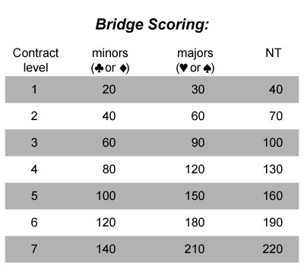
Introduction
Bridge scoring system
Bonuses:
Game bonus: 300/500
3NT, 4♥, 4♠, 5♣, 5♦
Small slam bonus: 500/750
6NT, 6♥, 6♠, 6♣, 6♦
Grand slam bonus: 1000/1500
7NT, 7♥, 7♠, 7♣, 7♦
Notes:
Linear, except for bonuses. Don’t need to remember any of this scoring, just that there are bonuses for games and slams! When you can make games or slams you should be bidding them!

Slide 7
Introduction
So what is the bidding strategy?
- Stay as low as possible unless you have a reasonable chance of making a bonus!
♠ K54
♥ AK96
♦ 762
♣ 7652
- North-South have 28 points and can make 9 tricks.
- 1NT+2 scores less than 3NT= so it is better to bid for the bonus. 3NT is 600 and 1NT+2 only 150.
♠ QT98
♥ T87
♦ JT54
♣ K8
♠ J6
♥ 542
♦ Q98
♣ QJT98
3NT
♠ A732
♥ QJ3
♦ AK3
♣ A43
Question: How many points do I between partner and me to bid for a bonus?
Answer: - 25 points combined between you and you partner for game.
- 32-33 for a small slam.
- 36 for grand slam.
Notes:
Example hand: how many tricks do you think N-S can make here? They can make 9 tricks. That is a game in No Trumps but not in any other suit so you want to be in 3NT to get the bonus! Generally you need 25 hcps for games, 32-33 for small slam and 36 for a grand slam.

Slide 8
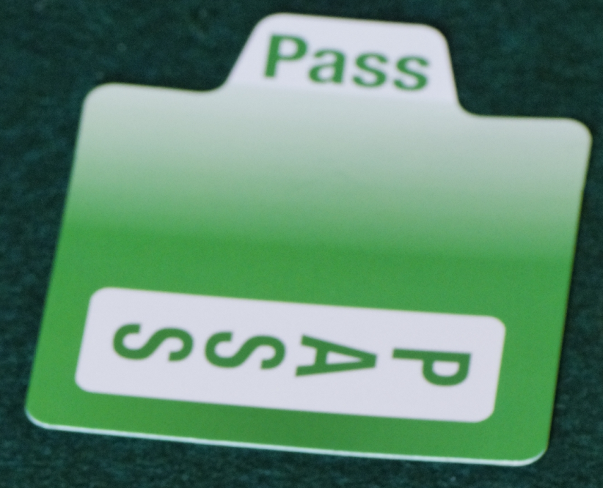
Introduction
What happens if I bid more tricks than we can make?
YOU GET A PENALTY!!
The opponents get 50 or 100 per trick you need more to make it.
Question: so how do I bid when I have a bad hand that makes no tricks?
Answer: you Pass, which is a bid you make whenever you don’t have enough points. It doesn’t commit your side to make any more tricks than you already have.

Slide 9
Introduction
The opening bid
Question: so I have the minimum of 12 points to open the bidding, where do I start? 1♣, 1♦, 1♥, 1♠ or 1NT? Can I bid at the 2-level?
Answer: generally you bid the suit you have most of. This way partner knows you have length in the suit and if he has too, it will often be better to play in that suit than any other contract because you have trumps for extra tricks.
You tend to start bidding at the 1-level first to you take up less bidding space (remember you always have to bid higher than the previous bid).
This way you leave more rooms for more bids without committing to too many tricks right away. The more bids you make the better you describe your hand and the more accurately you can judge the best final contract.

Slide 10
Introduction
Some examples:
1♣ = 12+ points and 3+♣
1♦ = 12+ points and 3+♦
1♥ = 12+ points and 5+♥
1♠ = 12+ points and 5+♠
NB: Higher ranked suits have priority if equal length.
♠ A32
♥ K82
♦ Q65
♣ A954
♠ 65
♥ K3
♦ AK653
♣ A954
♠ J5
♥ A4
♦ Q765
♣ KQJ954
♠ AKQ52
♥ J8
♦ Q9
♣ A954
♠ KQ4
♥ -
♦ AK965
♣ AJ954
♠ A743
♥ Q6
♦ Q965
♣ A94
♠ Q52
♥ K8
♦ A965
♣ A954
♠ A543
♥ JT98
♦ Q5
♣ A54
♠ AJT63
♥ AQJ54
♦ Q9
♣ A
♠ Q65
♥ K8
♦ Q87
♣ AK954
♠ AT52
♥ 4
♦ AJT4
♣ A954
♠ KJ52
♥ -
♦ Q652
♣ A7542
♠ AKT52
♥ 3
♦ AKQ965
♣ J

Slide 11
Introduction
Overview:
- Counting points: A = 4, K = 3, Q = 2 and J = 1
- Bonuses are given for bidding and making game and slams.
- 25 points for game, 32-33 for small slam and 36 for grand slam.
- Try to stay low unless you can get one of the bonuses.
- When you have a bad hand you can Pass, that way you don’t get penalties!
- You need at least 12 points to start the bidding.
- You start bidding at the 1-level to leave space for the most descriptive bids.
- To open you need at least 5 cards in the suit for 1 ♥/♠ and 3 for 1 ♣/♦.
- When equal length, bidding higher ranked suits have priority.

Slide 12

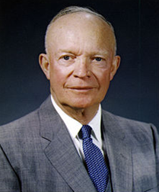
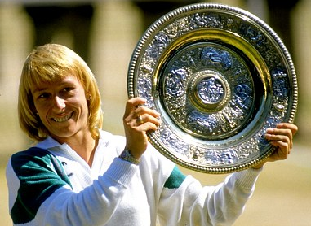

Introduction
Famous Bridge players
Bill Gates: business magnate, author, philanthropist , chairman of Microsoft.
Dwight Eisenhower: WWII general & 34th president of US.
Martina Navratilova: tennis legend and winner of 59 Grand Slam titles.
Warren Buffet: investor, industrialist and philanthropist.
Others include:
Winston Churchill, Den Xiaoping, Omar Sharif, Buster Keaton and Margaret Thatcher.

Slide 13
Introduction

