Slide 1
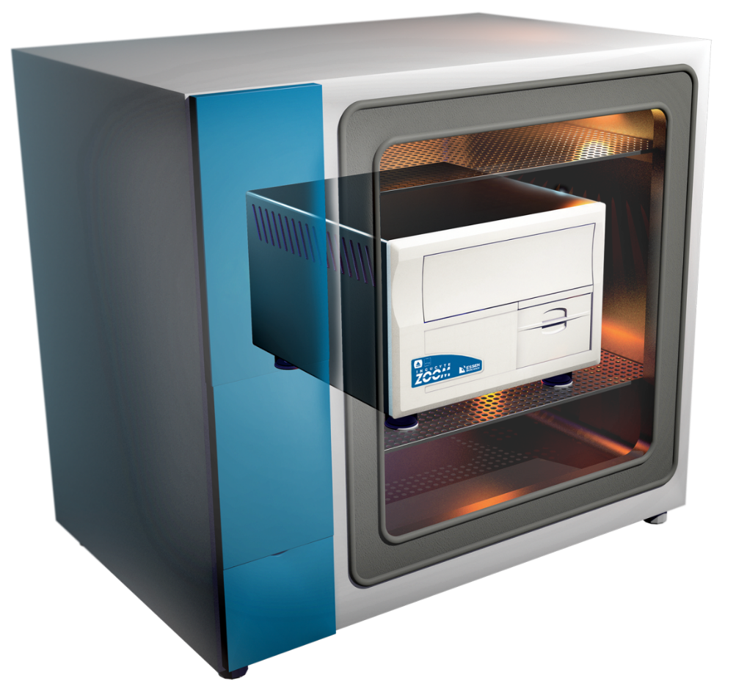
IncuCyte™ Live-Cell Imaging System
Real-Time visualization and automated data analysis – directly inside your incubator.
SEMINAR
LECTURE THEATRE G34
Sir Alexander Fleming Building
Monday 1 February 12.30pm – 1.30pm

