Slide 1

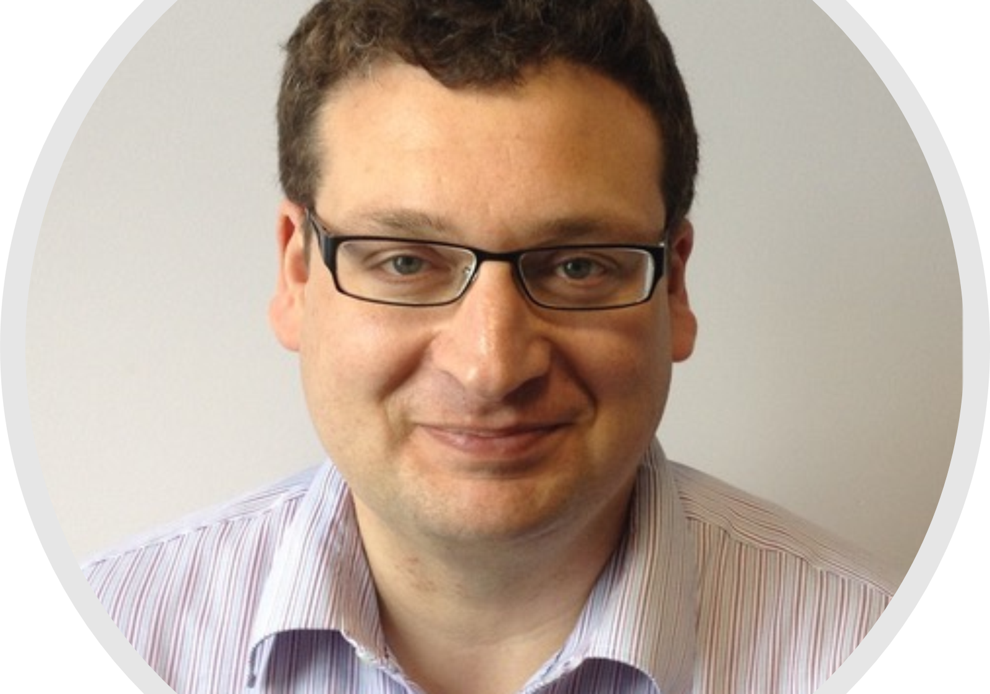
IRDB/ONCOLOGY
AUTUMN/WINTER SERIES SEMINAR 2019
“New insights into placental transport arising from 3D imaging and mathematical modelling”
Dr Professor Rohan Lewis,
Professor of Placental and Integrative Physiology,
Southampton University
Host: Dr Beth Holder
Thursday 24.10.19, 13.30-14.30
IRDB Seminar Room, Ground Floor IRDB Building
Hammersmith Campus
TO MEET WITH SPEAKER AFTERWARDS, PLEASE CONTACT: Dr Beth Holder
Tel: 020 7594 1773 (internal ext. 41773); Email: b.holder@imperial.ac.uk

